Slide 1
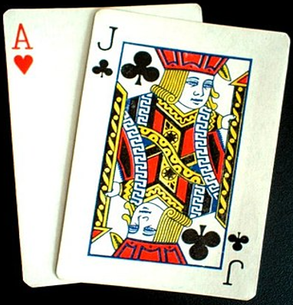
Project 1: Game in Python BlackJack
Program by:
François-Régis André
Anh Huynh

Slide 2

Summary
Rules of the game
Flowchart.
Create a program of the process using Python
Q & A

Slide 3
Rules of the game
The Game is played with a standard deck of 52 playing cards.
Players draw cards until they decide to stand. Dealer stands at 17 points or more.
They will lose if they have more than 21 points.
Players win if they have more points than dealer and not more than 21

Slide 4
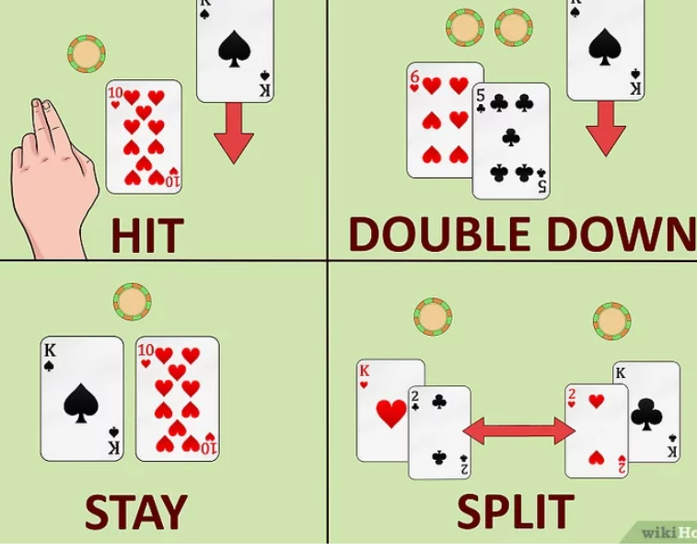
If the player’s first 2 cards are a pair:
they can split and separate their 2 cards in 2 hands
bet an identical amount on the 2nd
hand and play each separately.

Slide 5
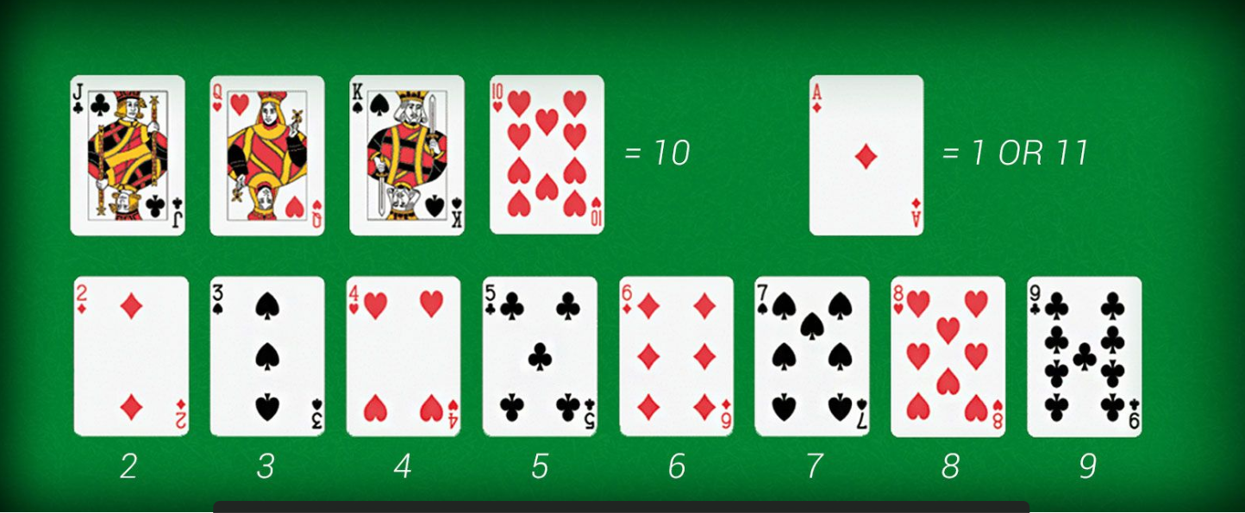
CARDS’ VALUE

Slide 6
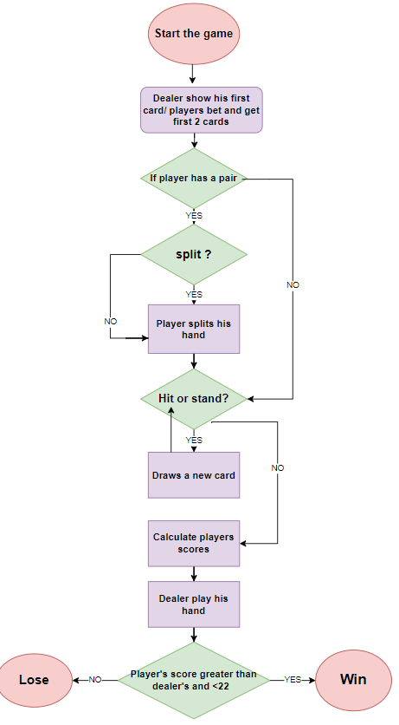
FLOWCHART

Slide 7
Create a program of the process using Python
Creating the data structure
Creating and shuffling the deck
Implementing the game

Slide 8


let's code “BLACKJACK”
and play the gamE!!!!!!

Slide 9
Q & A

